Slide 1

Introduction to Computer Science: Programming Methodology
Tutorial 10
Algorithm aNALYSIS

Slide 2
Primitive operations
Counting primitive operations:
~ Assigning an identifier to an object
~ Performing an arithmetic operation
~ Comparing two numbers
~ Calling a function
…
Measuring operations as a function of input size.
To capture the order of growth of an algorithm’s running time, we will associate, with each algorithm, a function f(n) that characterize the number of primitive operations as a function of input size.

Slide 3
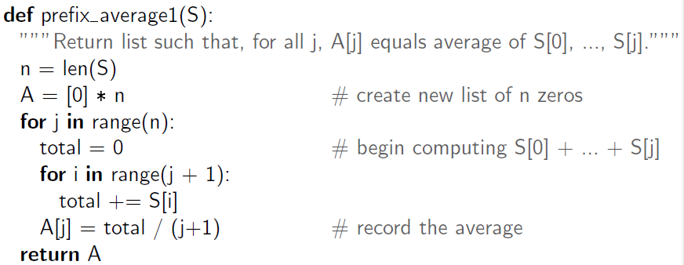
An quadratic-time algorithm
Example:
O(1)
O(n)
O(n)
n(n+1)/2->O(n²)
O(n)
The running time of this program is O(n²): quadratic-time algorithm

Slide 4
Q1: Verify 8nlogn better than 2n²
In this tutorial, logn means log₂n.

Slide 5
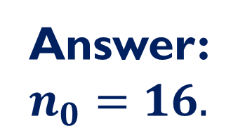
Q1: Answer
Answer: $n_{0}=16.$

Slide 6
Q2: Verify 40n² better than 2n³

Slide 7
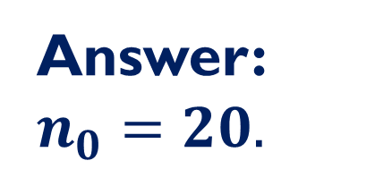
Q2:Answer
Answer: $n_{0}=20.$

Slide 8
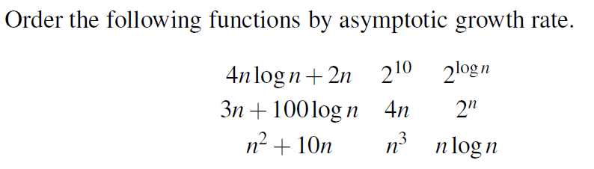
Q3: Ordering functions asymptotically
Hints: Using Matlab, Python(download matplotlib module) or Excel to plot the graph of each function for n in the range [0,10], [0,100], [0,1000] respectively.

Slide 9
Q3: Answer-I

Slide 10
Q3: Answer-II
Answer: Asymptotically 2^{n}>n³>n²+10n>4nlogn+2n>3n+100logn

Slide 11

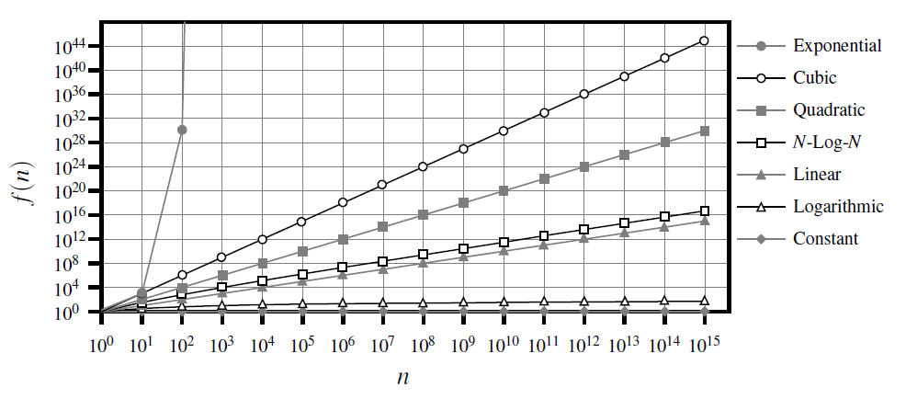
Conclusion

Slide 12
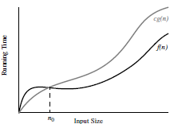
Definition of Big-Oh Notation
Definition: Let f(n) and g(n) be functions mapping positive integers to positive real numbers. We say that f(n) is O(g(n)) if there is a real constant c>0 and an integer constant n₀≥1 such that
f(n)≤cg(n), for n ≥ n₀
This definition is often referred to as the ‘big-Oh’ notation, for it is sometimes pronounced as ‘f(n) is big-Oh of g(n).’ Or you can say ‘f(n) is order of g(n)’.

Slide 13
Q4: Prove Big Oh of a function
Use the definition of Big Oh notation shown before to
i) Show that 8n+5 is O(n).
ii) Show that 5n⁴+3n³+2n²+4n+1 is O(n⁴).
iii) Show that 5n²+3nlogn+2n+5 is O(n²).
iv) Show that 16nlogn+n is O(nlogn).
Rules: Characterizing functions in simplest terms.
Use the 7 functions. Our 7 functions are ordered by increasing
growth rate in the following sequence.
better
worse

Slide 14
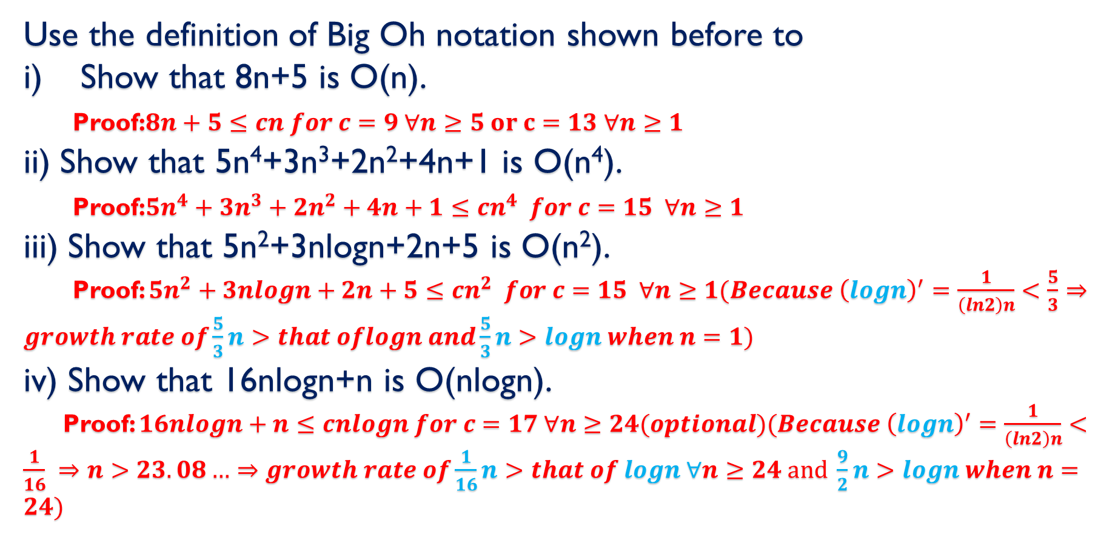
Q4: Answer
Use the definition of Big Oh notation shown before to
Show that 8n+5 is O(n).
Proof:$8n+5≤cn for c=9 ∀n≥5 or c=13 ∀n≥1$
ii) Show that 5n⁴+3n³+2n²+4n+1 is O(n⁴).
Proof:$5n^{4}+3n^{3}+2n^{2}+4n+1≤cn^{4} for c=15 ∀n≥1$
iii) Show that 5n²+3nlogn+2n+5 is O(n²).
Proof: $5n^{2}+3nlogn+2n+5≤cn^{2} for c=15 ∀n≥1(Because {\left(logn\right)}^{′}=\frac{1}{\left(ln2\right)n}<\frac{5}{3}⇒growth rate of\frac{5}{3}n>that oflogn and\frac{5}{3}n>logn when n=1)$
iv) Show that 16nlogn+n is O(nlogn).
Proof: $16nlogn+n≤cnlogn for c=17 ∀n≥24(optional)(Because {\left(logn\right)}^{′}=\frac{1}{\left(ln2\right)n}<\frac{1}{16} ⇒n>23.08…⇒growth rate of\frac{1}{16}n>that of logn ∀n≥24 and \frac{9}{2}n>logn when n=24)$

Slide 15
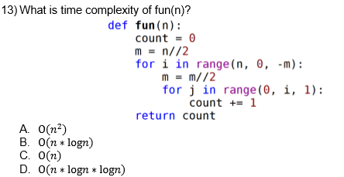
Q5: Time Complexity

Slide 16
Q5:Answer
Answer: C
Reason: given an n, you can try to print out count, then you will find count~n, which means time complexity is O(n).

Slide 17
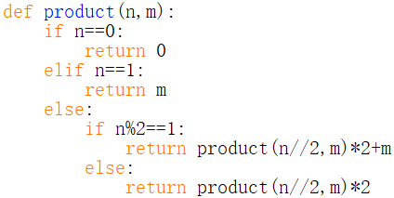
Q6:Time complexity
i)What is the functionality of the function product()?
ii)What is the time complexity of this function?

Slide 18
Q6: Answer-I
i)The functionality of the function product(n,m) is to calculate the product of n and m, that is n*m.
ii)The time complexity of this function is O(logn). The reason is on the next ppt, in which we design an algorithm to count the number of primitive operations in the function.

Slide 19
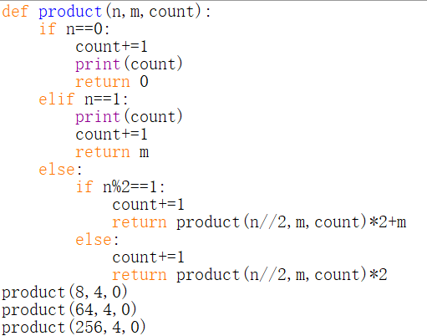

Q6:Answer-II
Reason: count is used to count the primitive operation in the function. For n=8, count=3; for n=64, count=6; for n=256, count=8, and so on. So the time complexity of the function product is O(logn).

